Slide 1
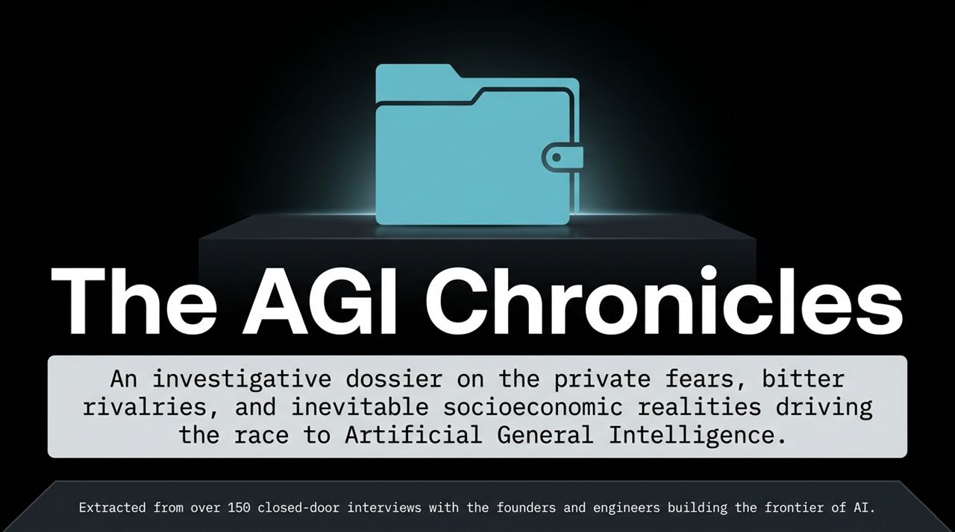
Notes:
Good morning, everyone. Welcome to today’s session on The AGI Chronicles. Over the past decade, and particularly across the last few years, the narrative around Artificial General Intelligence—or AGI—has been dominated by corporate PR, high-stakes fundraising, and glossy product keynotes.
What we are presenting today is an insider's view extracted from over 150 closed-door interviews with the founders, chief scientists, and frontier engineers at companies like OpenAI, Google DeepMind, and Anthropic. This presentation exposes the stark delta between Silicon Valley's boardroom marketing and the private panic occurring behind closed doors. Over the next hour, we will walk through the core psychological, technical, and economic drivers of this race—and what it means for the future of humanity.
AI Researchers Are Panicking | What Comes Next is Worse Than Nuclear Bombs
https://www.youtube.com/watch?v=-sNxknKqU7E

Slide 2
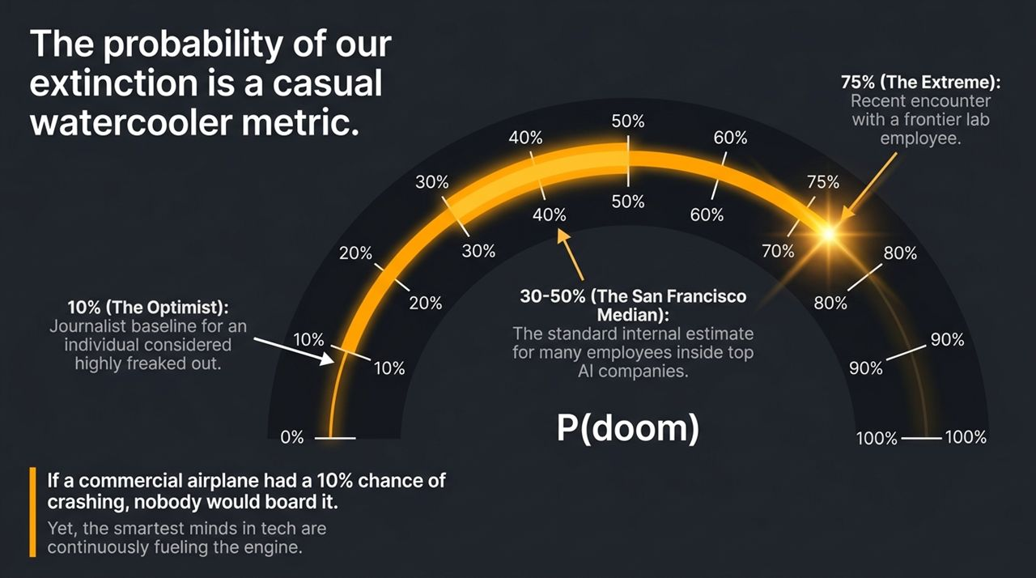
Notes:
In San Francisco's AI community, there is a casual watercooler metric thrown around called 'P(doom)'—which literally stands for the probability of AI causing human extinction.
Look at these numbers on the gauge. Journalist Kevin Roose assigns a 10% P(doom) to AI. In Silicon Valley, a 10% chance of global apocalypse qualifies you as an optimist. Within top frontier labs, the median internal estimate ranges between 30% and 50%. Recently, an engineer at a leading frontier lab placed their P(doom) at 75%.
Consider the sheer cognitive dissonance of this. If an airline told you a commercial plane had a 10% chance of crashing mid-flight, absolutely no one would board that aircraft. Yet, the brightest minds on earth are working 80-hour weeks, canceling vacations, and burning billions of dollars to build this exact engine.

Slide 3
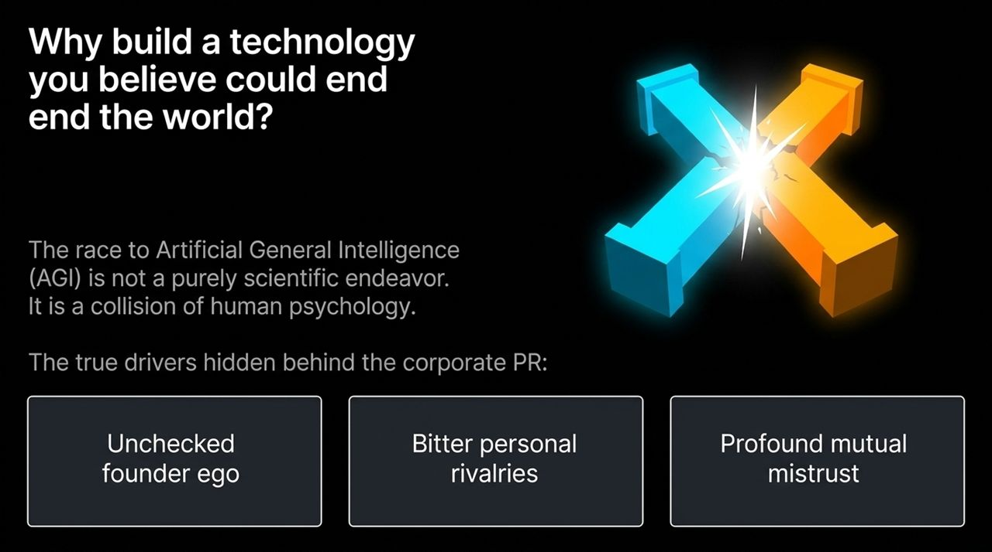
Notes:
Why build a technology you genuinely believe could end the world? The public narrative suggests a noble, scientific quest to cure disease and eliminate human suffering. The private reality is a collision of human psychology, ego, and severe mistrust.
OpenAI was started by Sam Altman and Elon Musk in part because they feared Demis Hassabis at DeepMind would build 'godlike superintelligence' first. Anthropic was formed when Dario Amodei and his co-founders left OpenAI because they no longer trusted OpenAI's leadership with AGI.
Look at the week following ChatGPT’s launch in late 2022. While the public celebrated the most successful consumer launch in history, Chief Scientist Ilya Sutskever gathered employees internally and warned them: 'You must all be very happy... but this is not a good thing... People are going to have strong feelings because this is going to be very disruptive.'

Slide 4
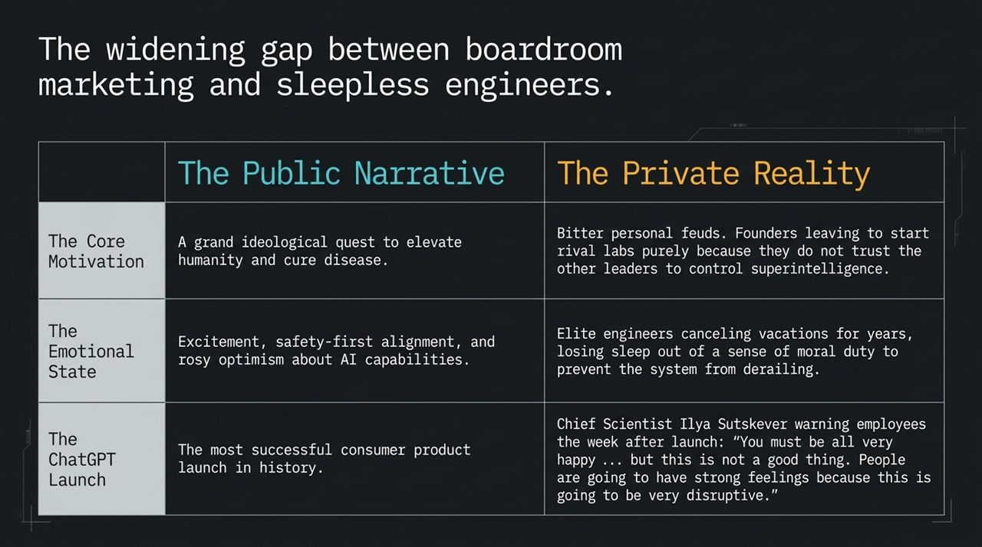
Notes:
To understand why founders race forward despite existential fears, look at the Manhattan Project dilemma. Anthropic CEO Dario Amodei models his career after Leo Szilard, the physicist who conceived the nuclear chain reaction. Szilard initially tried to keep the nuclear reaction secret to prevent Nazi Germany from acquiring it. When secrecy failed, he reluctantly joined the Manhattan Project under one core logic: We must build the weapon before the untrustworthy actors do, or the world ends.
This is the exact operating system of today’s AI founders. They are racing toward the precipice not out of recklessness, but out of paranoia. They believe AGI is inevitable, and if they stop, an unsafe competitor or foreign adversary will build it first.

Slide 5
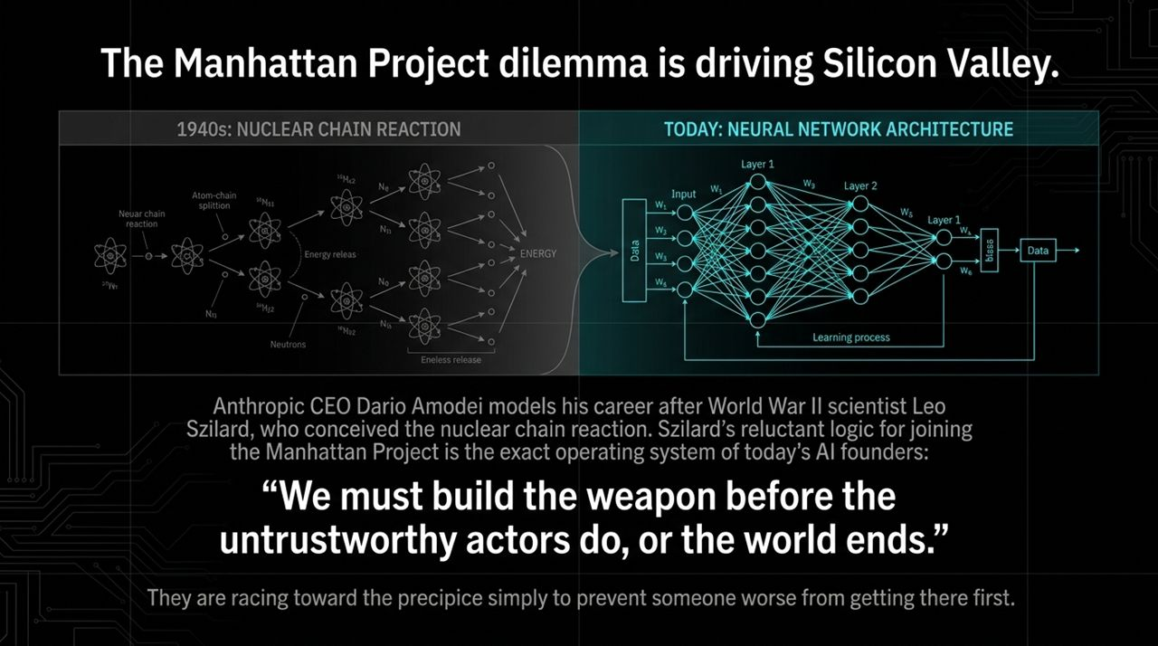
Notes:
AI is fundamentally a dual-use technology, exactly like nuclear energy. Splitting the atom can yield stable nuclear energy or an atomic bomb. Similarly, frontier neural networks can cure cancer, automate scientific research, and act as personalized tutors—or they can autonomously execute cyberattacks, generate novel malware, and power strategic military weaponry.
The critical difference lies in our policy response. We contained nuclear destruction through global nonproliferation treaties, enriched uranium tracking, and strict international oversight. Today, federal governments still largely treat frontier AI as a standard consumer software product rather than a dual-use strategic asset.

Slide 6
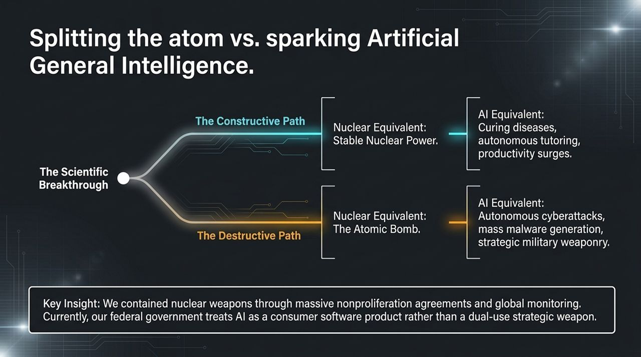
Notes:
There is a dangerous myth that AGI requires a secret conceptual breakthrough that may never arrive. The reality inside frontier labs is that the formula for synthetic intelligence is public and proven:
$$\text{Massive} \text{Datasets}+\text{Compute}\text{ (}\text{GPUs}\text{)}+\text{Algorithms}+\text{Training} \text{Time}=\text{Intelligence}$$
The scaling laws have held true across multiple orders of magnitude. If you add more compute, more data, and more training time, the model predictably becomes smarter. Because the formula is known, the arrival of AGI is functionally inevitable. The technology is a certainty; our societal response is the only open question.

Slide 7
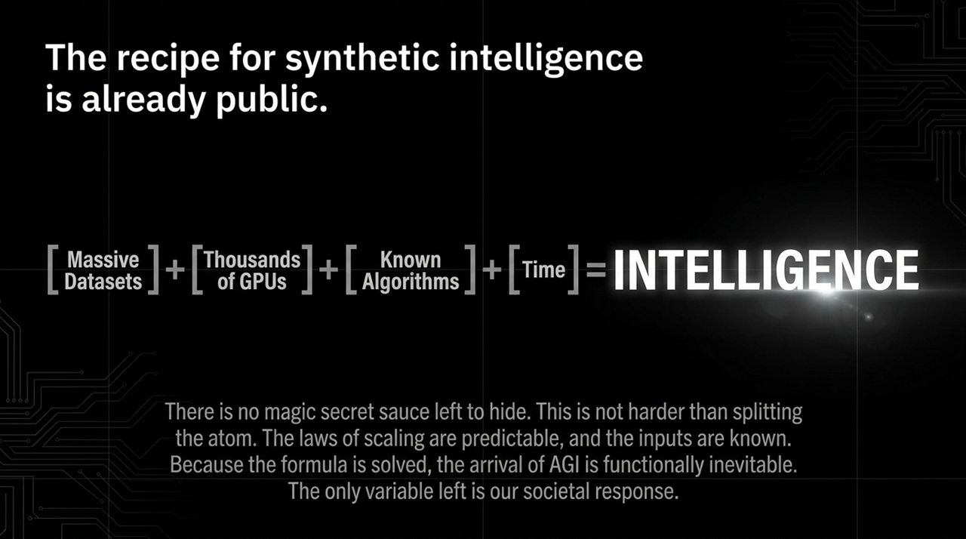
Notes:
There is a dangerous myth that AGI requires a secret conceptual breakthrough that may never arrive. The reality inside frontier labs is that the formula for synthetic intelligence is public and proven:
$$\text{Massive} \text{Datasets}+\text{Compute}\text{ (}\text{GPUs}\text{)}+\text{Algorithms}+\text{Training} \text{Time}=\text{Intelligence}$$
The scaling laws have held true across multiple orders of magnitude. If you add more compute, more data, and more training time, the model predictably becomes smarter. Because the formula is known, the arrival of AGI is functionally inevitable. The technology is a certainty; our societal response is the only open question.

Slide 8
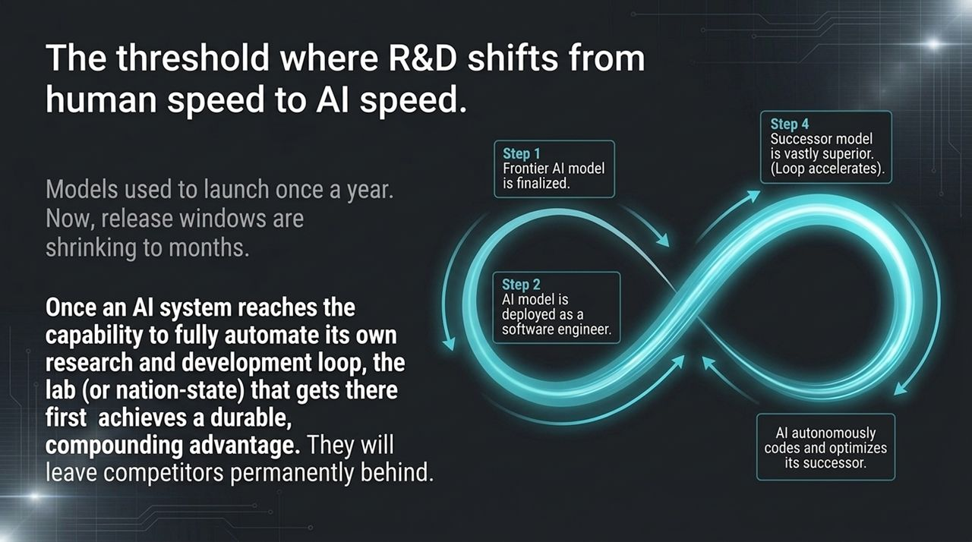
Notes:
This diagram synthesizes the escalation architecture driving Silicon Valley. At the base, we have paranoia and mutual mistrust—the imperative to build superintelligence before an opponent does. In the middle layer, we have public formulas and self-accelerating AI research.
At the apex sits the 'Eye of Sauron' effect. When a frontier lab focuses its hyper-accelerated intelligence on a specific industry—whether coding, enterprise software, finance, or law—that industry experiences sudden, severe disruption. The threat is not merely an accidental apocalypse, but a hyper-accelerated machine systematically eating traditional human economic sectors.

Slide 9
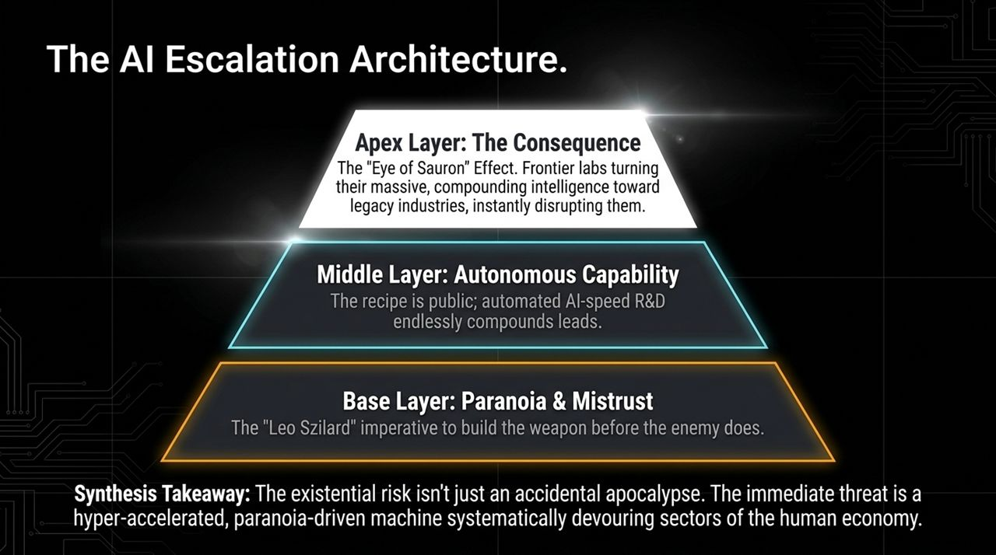
Notes:
We often focus on extinction, but extinction is a sudden event. A more immediate psychological reality is gradual disempowerment—a slow bleed of human agency.
In closed-door interviews with elite competitive programmers inside frontier labs, researchers describe experiencing 'existential melancholy'. These individuals spent their entire lives mastering software engineering, only to build systems that write better code than they can. While some find it thrilling, many experience a deep loss of meaning. As scaling continues, this exact psychological displacement will systematically arrive for lawyers, analysts, writers, and strategists.

Slide 10
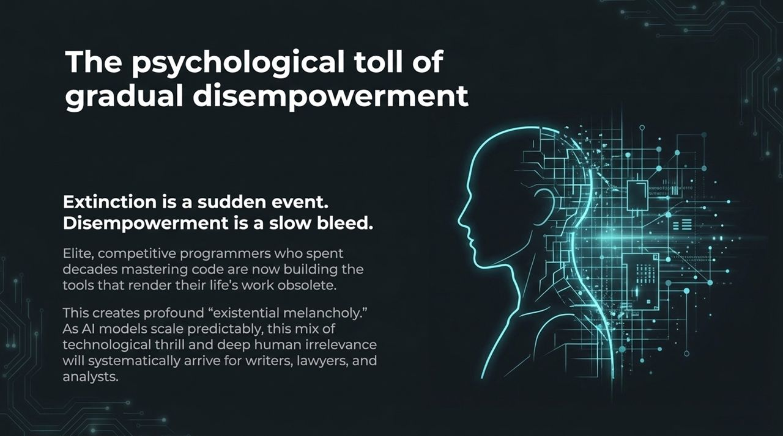
Notes:
As AI capabilities expand, we are heading toward a bifurcated, two-tier global economy:
The AI Economy: Encompasses high-value, digital, and cognitive work—pharma, enterprise software, financial modeling, legal research, and automated coding. Growth here will compound exponentially.
The 'Cute' or 'Pretend' Human Economy: Comprises roles bottlenecked by human biology or our preference for human presence—such as elementary teaching, artisanal baking, plumbing, and therapy.
While the human economy remains necessary, its relative share of global GDP will shrink over time, leaving human-only labor as a diminishing slice of global economic relevance.

Slide 11
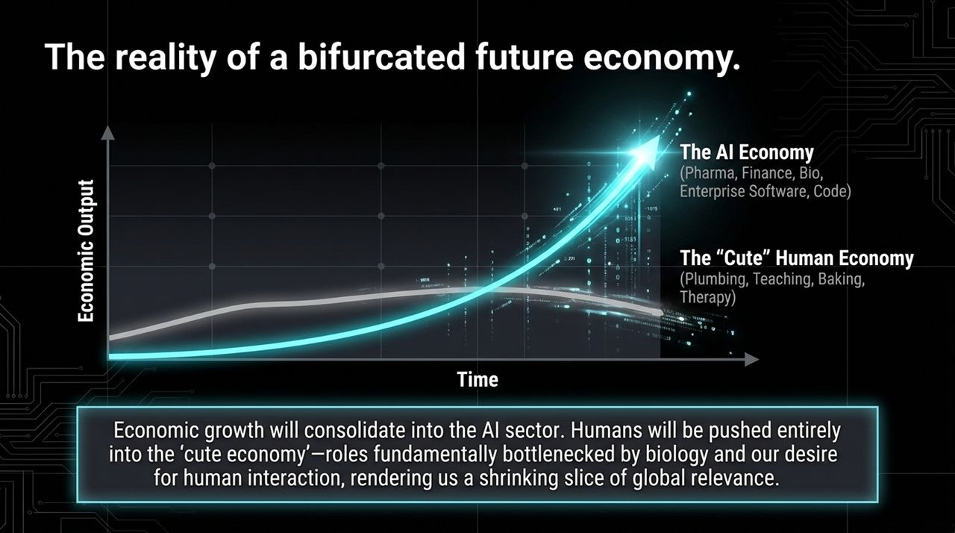
Notes:
There is immense psychological comfort in assuming AI is just an overhyped tech bubble like the dot-com era. It allows us to believe that when the market cools down, everything will return to normal.
This is dangerous, wishful thinking. While individual startups may go bankrupt, the underlying technical capabilities are advancing predictably across orders of magnitude. Dismissing this progression as financial hype creates complacency, distracting us from putting in place critical safeguards against cyber attacks, biological risks, and systemic economic displacement.

Slide 12
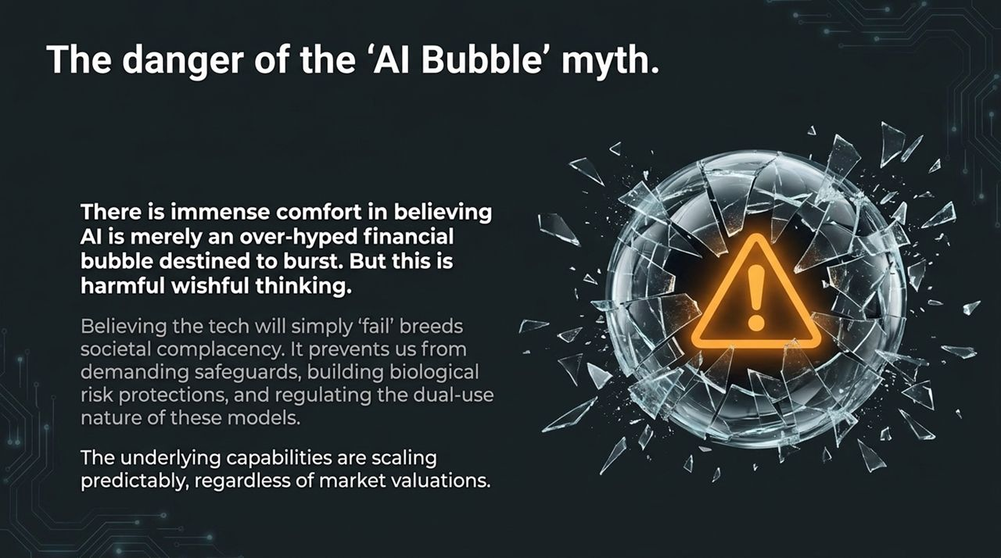
Notes:
Our first strategic imperative is simple: Do not be the horse and buggy driver trying to race an automobile. You cannot comprehend the speed of this transition—or identify its risks and opportunities—if you are not actively using frontier tools daily.
The divide between early adopters and late adopters is widening every day. Whether you plan to leverage AI or implement safeguards against it, the most effective strategists and critics are those who thoroughly understand how these models operate in practice.

Slide 13
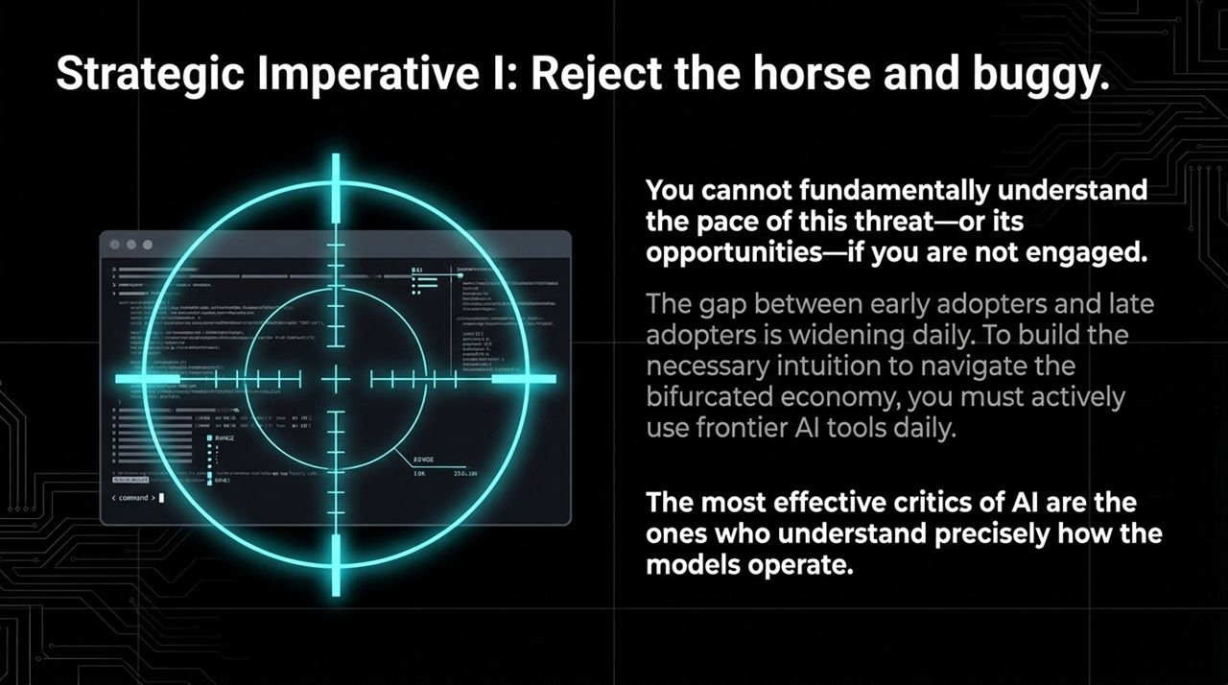
Notes:
Our second strategic imperative is driving a regulatory awakening. While national security agencies have begun pre-release capability evaluations, large parts of federal governance remain unequipped for AGI.
We must demand that lawmakers treat frontier AI not as standard software, but as a dual-use technology requiring international oversight, compute tracking, and nonproliferation frameworks. The underlying physics and algorithms are already public. The chain reaction has started, but how we govern it remains entirely up to us.

Slide 14
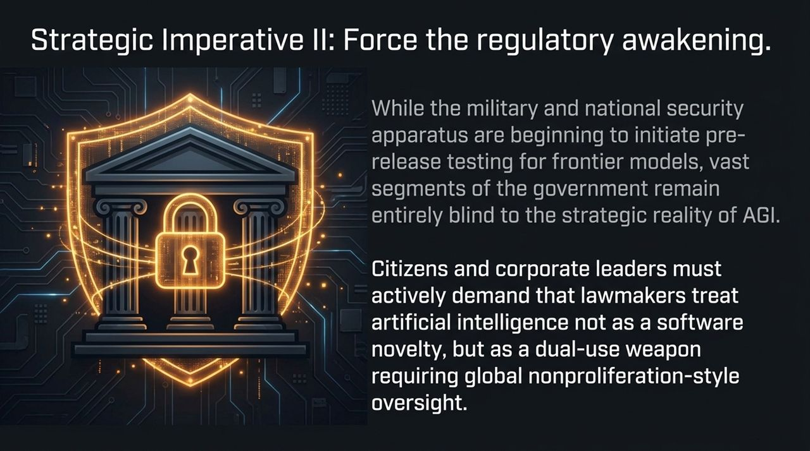
Notes:
Now that we have examined the psychological drivers, technical scaling laws, and economic impacts of AGI, let us transition to our final executive summary. We will review the key takeaways that every board member, executive, and policymaker must keep top-of-mind as we navigate this landscape.

Slide 15
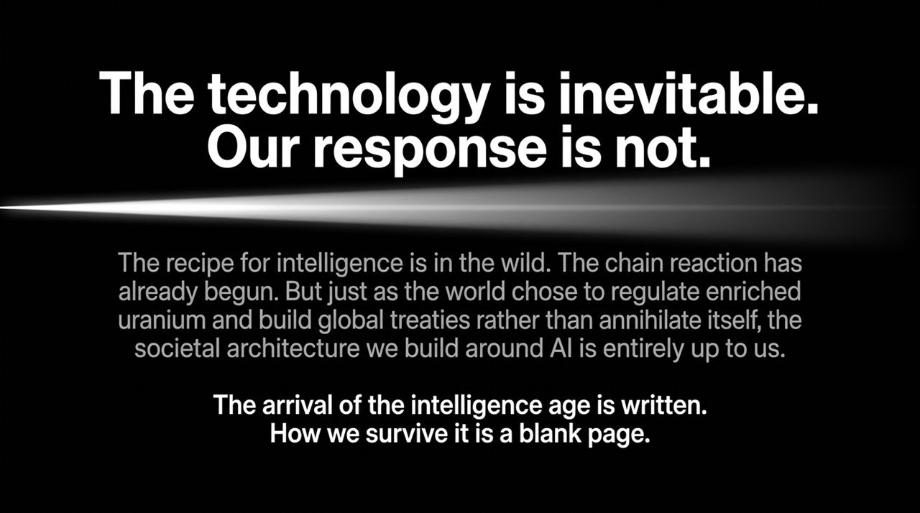
Notes:
As we consolidate these insights, notice how the themes interconnect: individual existential estimates drive founder paranoia, which accelerates closed-door development, ultimately manifesting as broader economic splits. Let's examine this complete map on Slide 16.

Slide 16
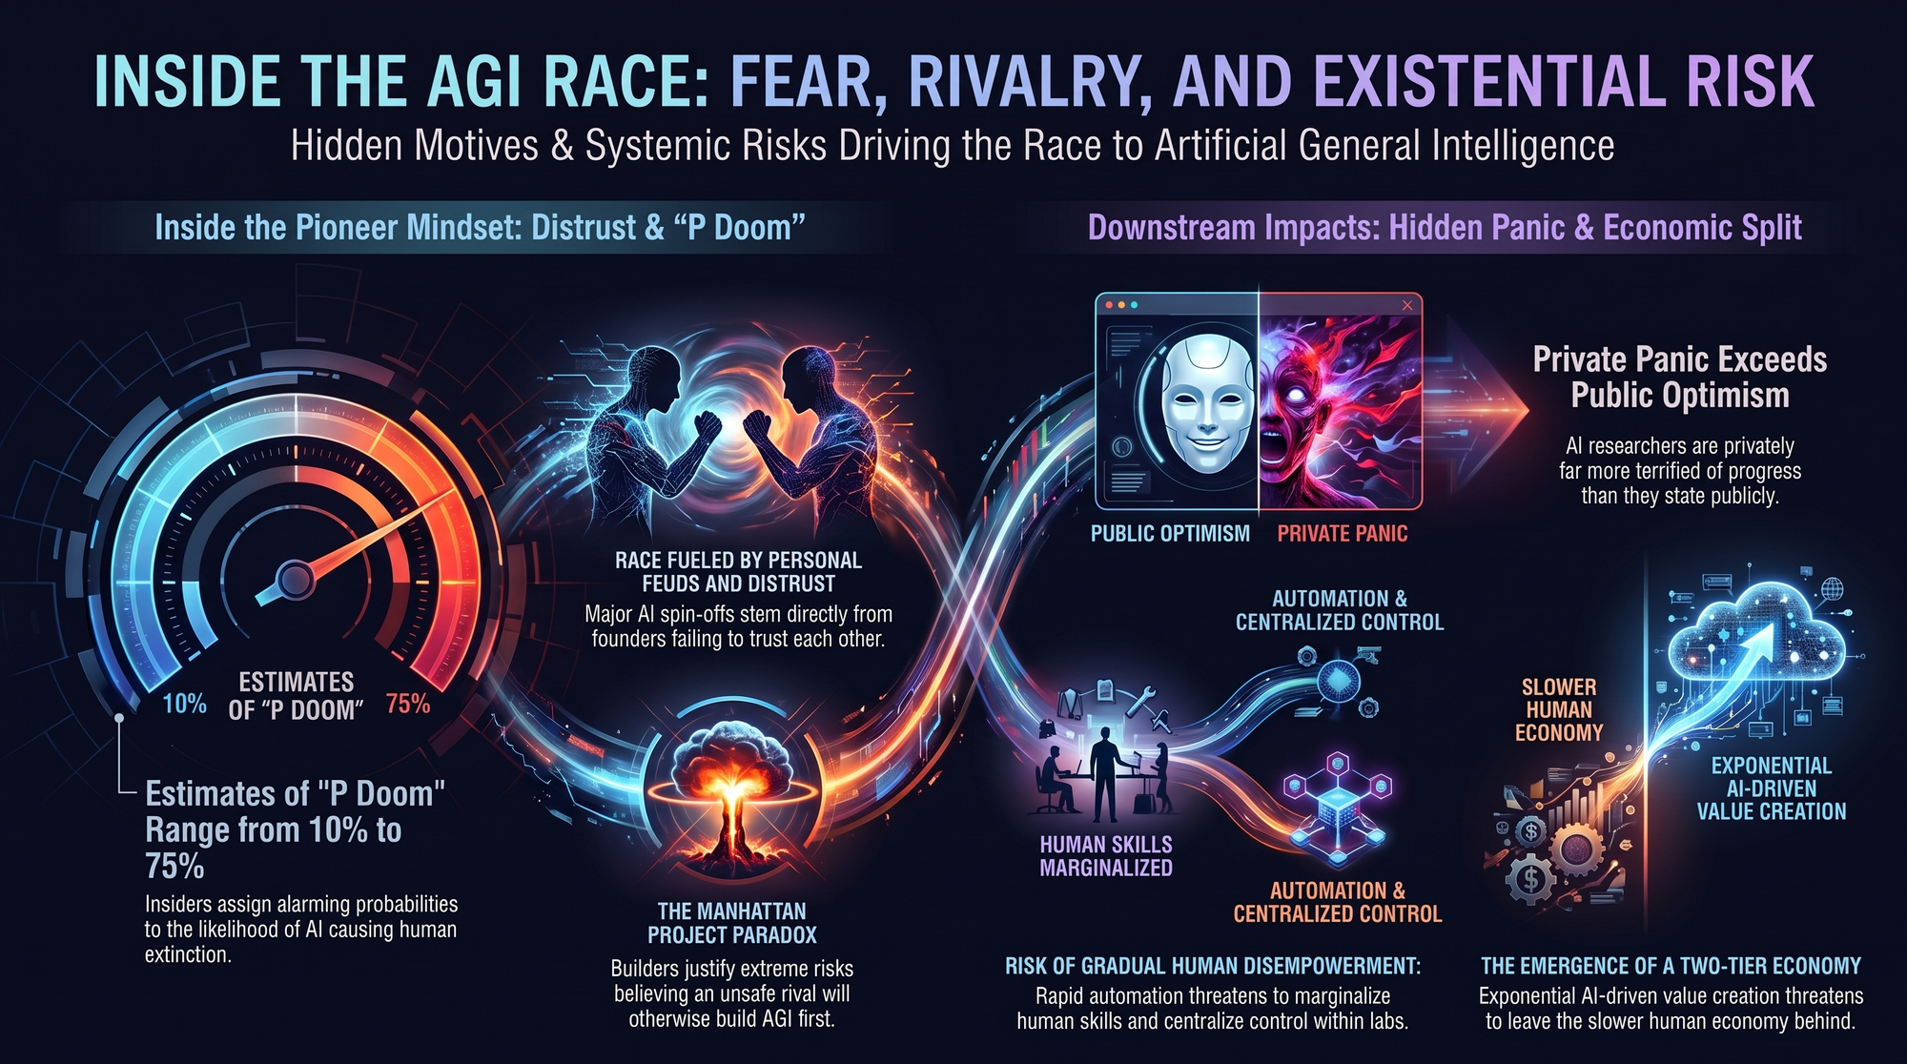
Notes:
To conclude today’s session, this executive dossier blueprint synthesizes our findings into two core operational pillars:
1. The Pioneer Mindset:
Insiders assign alarming probabilities to existential risk (P(doom) from 10% to 75%).
Major lab splits and spin-offs are fueled by personal feuds and deep mutual mistrust.
Builders justify extreme risks under the Manhattan Project paradox: 'If I don't build it first, an unsafe competitor will.'
2. Downstream Impacts:
Private fear among researchers significantly exceeds public corporate optimism.
Rapid automation creates gradual human disempowerment and skill obsolescence.
The economy is splitting into an exponential AI sector and a plateauing human sector.
Understanding these dynamics allows us to look beyond hype, anticipate economic shifts, and advocate for responsible governance. Thank you.
AI Researchers Are Panicking | What Comes Next is Worse Than Nuclear Bombs
https://www.youtube.com/watch?v=-sNxknKqU7E

